Slide 1
Lecture 20 – Recursive Algorithms
Factorial function, Fibonacci function, Hanoi Tower
Kok-Seng Wong | 2021

Slide 2
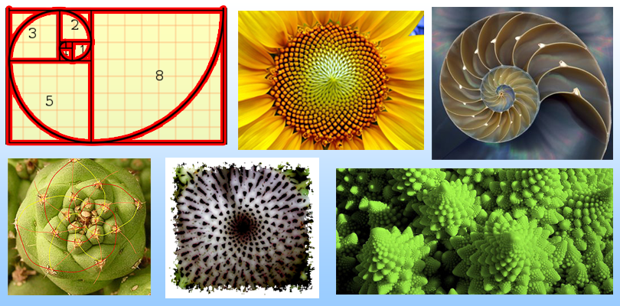
Motivation example
Fibonacci Sequence
[source]

Slide 3
Learning outcomes
Upon the completion of this lecture, students will be able to:
identify how to formulate programs recursively.
develop the recursive formulation to elementary problems such as factorial, Hanoi Tower, and Fibonacci sequence.

Slide 4
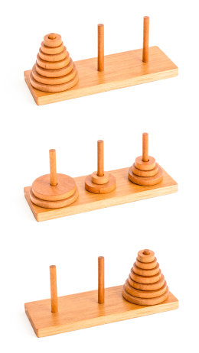
Tower of hanoi
The rules of the game:
Given 3 towers: left, middle, and right
n disks of unique sizes on left
Goal: move all disks from left to right
Can move only one disk at a time
Only the uppermost disk from the rod can be moved
Cannot put a larger disk on top of a smaller disk
middle
right
left
[source]

Slide 5

Tower of Hanoi: $n=2$
A
B
C

Slide 6
Tower of Hanoi: $n=2$
A
B
C

Slide 7
Tower of Hanoi: $n=2$
A
B
C

Slide 8
Tower of Hanoi: $n=2$
A
B
C

Slide 9

Tower of Hanoi: $n=3$
A
B
C

Slide 10
Tower of Hanoi: $n=3$
A
B
C

Slide 11
Tower of Hanoi: $n=3$
A
B
C

Slide 12
Tower of Hanoi: $n=3$
A
B
C

Slide 13
Tower of Hanoi: $n=3$
A
B
C

Slide 14
Tower of Hanoi: $n=3$
A
B
C

Slide 15
Tower of Hanoi: $n=3$
A
B
C

Slide 16
Tower of Hanoi: $n=3$
A
B
C

Slide 17

Tower of Hanoi: $n=4$
A
B
C

Slide 18
Tower of Hanoi: $n=4$
A
B
C

Slide 19
Tower of Hanoi: $n=4$
A
B
C

Slide 20
Tower of Hanoi: $n=4$
A
B
C

Slide 21
Tower of Hanoi: $n=4$
A
B
C

Slide 22
Tower of Hanoi: $n=4$
A
B
C

Slide 23
Tower of Hanoi: $n=4$
A
B
C

Slide 24
Tower of Hanoi: $n=4$
A
B
C

Slide 25
Tower of Hanoi: $n=4$
A
B
C

Slide 26
Tower of Hanoi: $n=4$
A
B
C

Slide 27
Tower of Hanoi: $n=4$
A
B
C

Slide 28
Tower of Hanoi: $n=4$
A
B
C

Slide 29
Tower of Hanoi: $n=4$
A
B
C

Slide 30
Tower of Hanoi: $n=4$
A
B
C

Slide 31
Tower of Hanoi: $n=4$
A
B
C

Slide 32
Tower of Hanoi: $n=4$
A
B
C

Slide 33
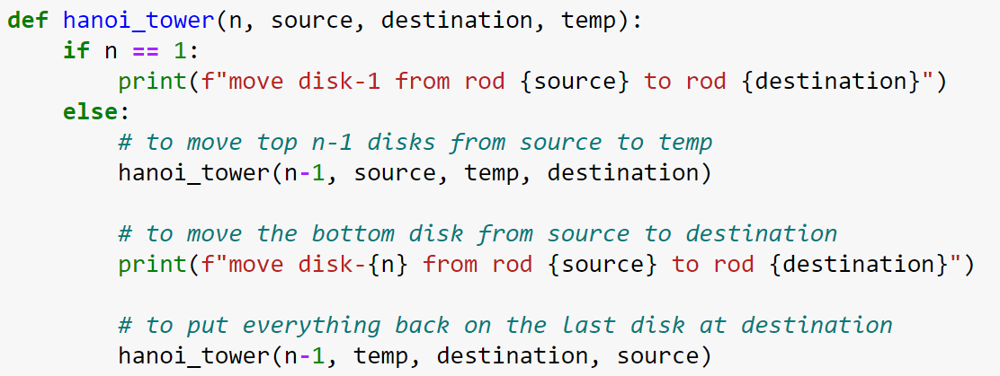
Tower of Hanoi algorithm

Slide 34
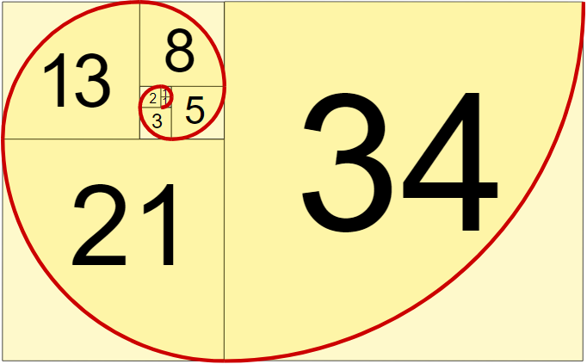

Fibonacci sequence
Fibonacci sequence: a sequence of integer values in which the first two values are both 1 and each subsequent value is the sum of the two previous values.
The first 10 terms of the sequence are:
1, 1, 2, 3, 5, 8, 13, 21, 34, 55, …
[source]

Slide 35
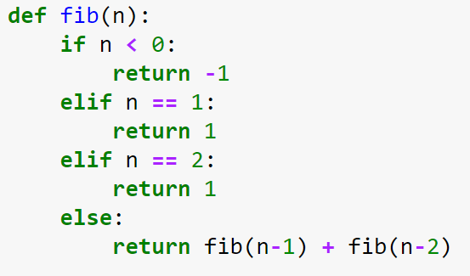
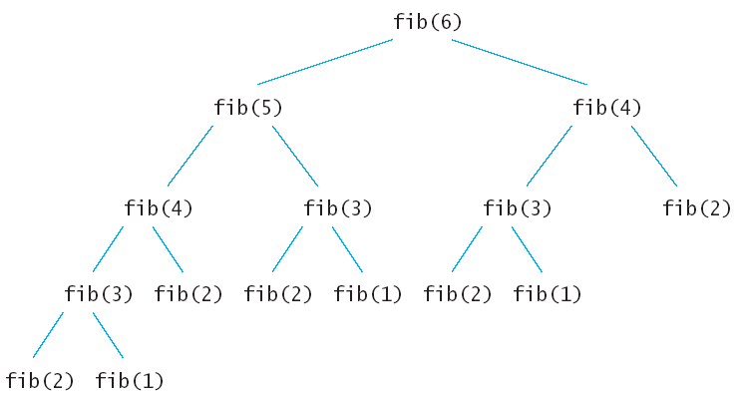
Fibonacci function

